Slide 2
W H A T R E A L L Y M A T T E R S ?
-- Philippians 1:8-11

Slide 3
Decisions Which Really Matter
Approve what is Excellent (Philippians 1:8-11)
Decisions by Moses (Hebrews 11:24-26)
Decisions by Joshua (Joshua 24:15)
Decisions by Joseph (Genesis 39:9)
Decisions by you and I (Proverbs 3:5,6; Romans 12:1,2)

Slide 4
WHO YOU ARE:
GENUINE
1 Timothy 1:5
NOT the attitude and actions of HYPOCRISY, nor COMPARISONS
2 Corinthians 10:10-13
Truth must be supreme, and Faithful to Truth is the highest character trait (Matthew 25:21,23; Revelation 2:10)

Slide 5
WHAT YOU DO:
SERVING
When Jesus came from heaven to earth (Matthew 20:25-28)
Become as children (Mark 9:33-37; Matthew 18:1-4)
Jesus -- Was He a celebrity or servant? (Philippians 2:5-8)
Reject entitlement/privilege

Slide 6
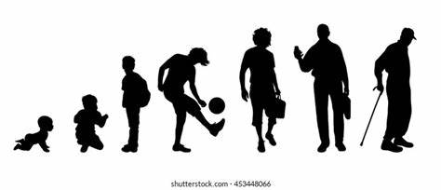
WHERE YOU ARE NOW
WHERE was Jesus at 12 years old? (Luke 2:49-52)
WHERE are you on the growth chart? (Ephesians 4:13-15)
Will you GROW to be a man/woman of God?
What will you be when you grow up?

Slide 7
What Really Matters to GOD ?
YOU ! John 3:16

